Slide 1
IML Final Project Presentation
Movie Success Prediction: Comparing Various Methods
Saptarishi Dhanuka

Slide 2


Slide 3
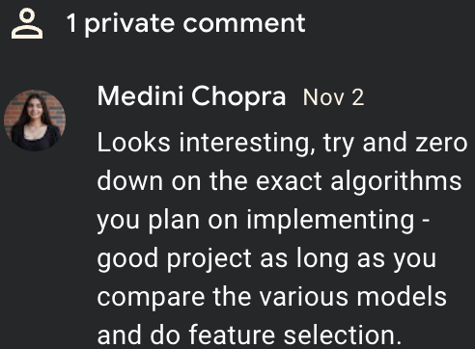
Proposal: Movie Box-Office Success Prediction
1. What I’m Doing
I will try to predict a movie’s success with a model that is based on various pre-release features like budget, country of origin, certification, movie studio, genre(s), main actors, director etc. I will also try to consider features like YouTube trailer views (for more recent movies) and other unconventional attributes for which I may need to augment the existing dataset that I use.
Success of a movie can be measured in multiple ways but I will just be considering its revenue as a multiple of its budget. This does not account for movies released directly on streaming or highly rated films that make minimal amounts of money. Based on the revenue-over-budget multiplier, I will classify the movie into various classes ranging from big flop to big hit; I will decide on the exact number of classes as I get started on the project.
2. How I Am Doing It
I will use multiple methods and contrast and compare their results along with trying to understand why a particular method works best and why another method doesn’t. I cannot specify the final details of the number of methods and which methods I will be using since there may be some time constraints and resources that might crop up, along with whether I can sufficiently understand all the methods I will be applying.
For the success classification problem I will try to use logistic regression, SVMs, decision trees, random forests, naive bayes and some other methods depending on the feasibility and my own understanding. I will also explore boosting and other ensemble methods. If it is feasible, I could also try exploring regression methods to get an exact revenue and roughly contrast the accuracy with the classification methods.
After discussing with Medini and various other TAs, I had to deviate a bit from what I mentioned in the proposal. A description of my project now is:
Classify movies by revenue-over-budget into 2 classes and compare the outcomes of 4 different models: Logistic, Decision Trees, Random Forests and KNNs
Input : Preprocessed and cleaned dataset
Output : Comparative analysis of classification methods
Dataset
I was looking through various datasets online on Kaggle and other sites but couldn't find
one that would have all the features that I wanted. Even with the existing datasets, I
could not choose one particular one that I would fix for the project. I may need to
combine features from various datasets and merge them for each movie.
Some datasets I am considering are TMDB, this, and this.
3. What I can show as proof
Apart from the project writeup, I can show the outcomes of some specific test cases of
movies or show the model’s prediction for a movie given by the course staff, subject to
the condition that the relevant data exists for the model to make a prediction for that
particular movie and that the movie was released after the movies used in the training
data.

Slide 4
Methodology

Slide 5
Dataset
movies_metadata.csv:
Information about movies: revenue, runtime, production_companies, genres etc
credits.csv
Information about cast and crew of each movie: All cast and crew for each movie

Slide 6
Data cleaning and preprocessing
Drop irrelevant columns with a lot of null values, and columns like keywords which would need techniques like word embeddings to use as features properly
Drop rows with revenue, budget, release year and runtime below a certain value to handle missing values, improve data quality, remove low outliers.
Extract one value from the list of production companies, spoken languages, production countries and spoken languages for simplicity
Dropping entries which have a production company that appears < 5 times overall in the dataset
Join with credits.csv and get the lead actor and director of each movie
Make a success_degree column based on revenue-over-budget
Final dataset: 4950 rows and 20 columns

Slide 7
Data Analysis

Slide 8
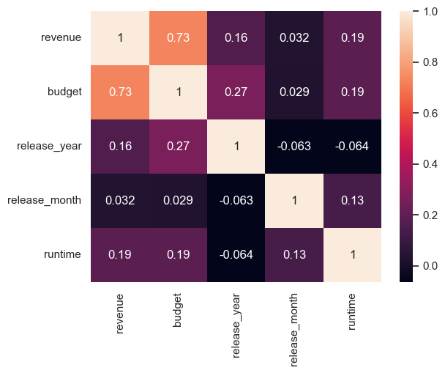
Correlation Between Revenue and Numeric Features

Slide 9
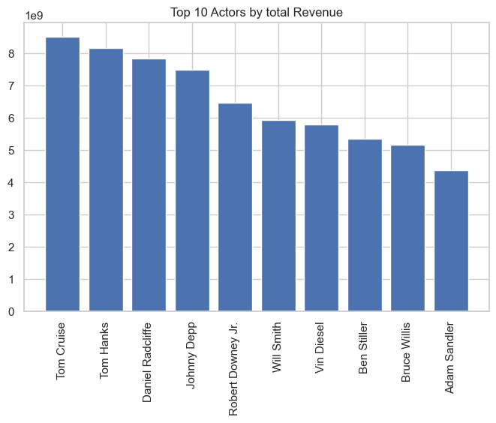
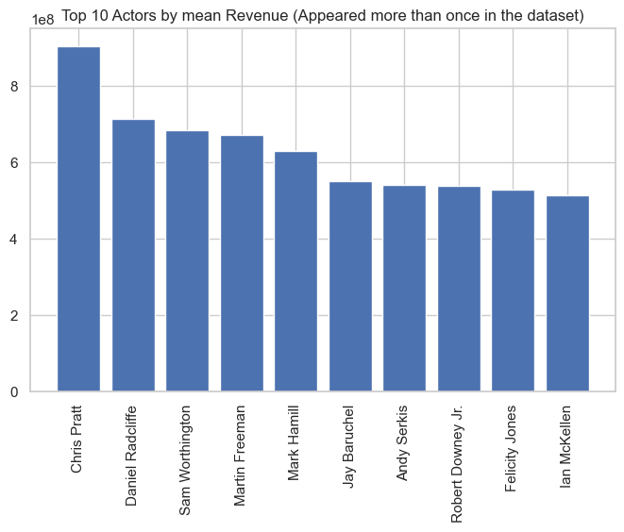

Slide 10
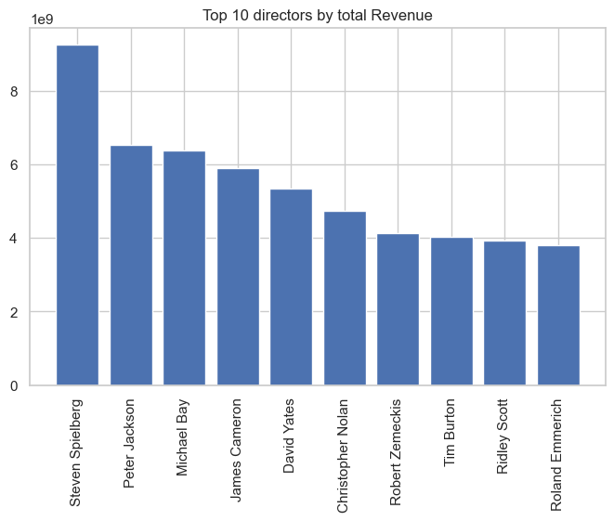

Slide 11
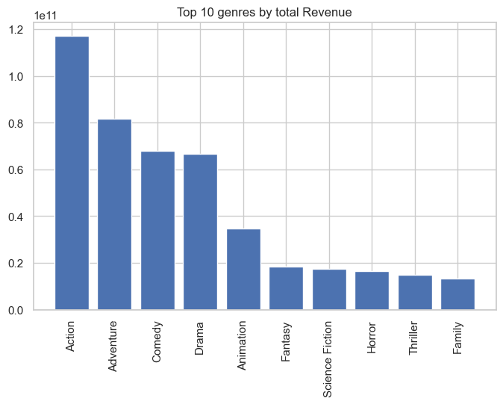

Slide 12
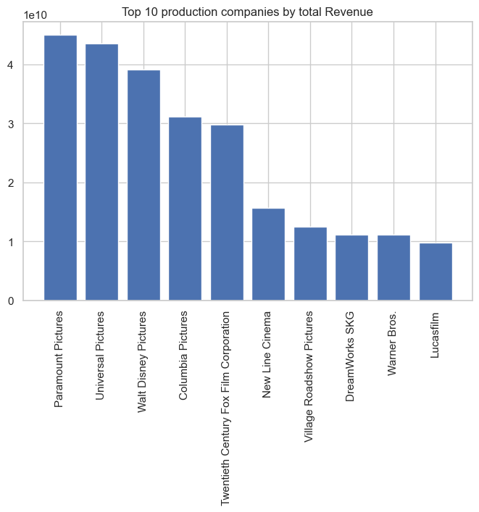

Slide 13
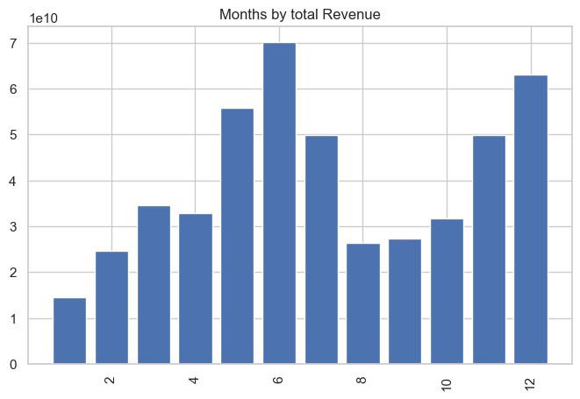

Slide 14
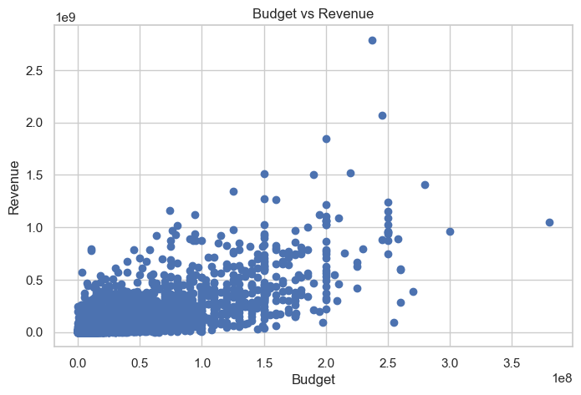
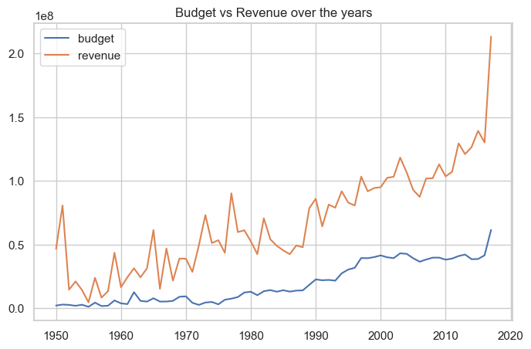

Slide 15
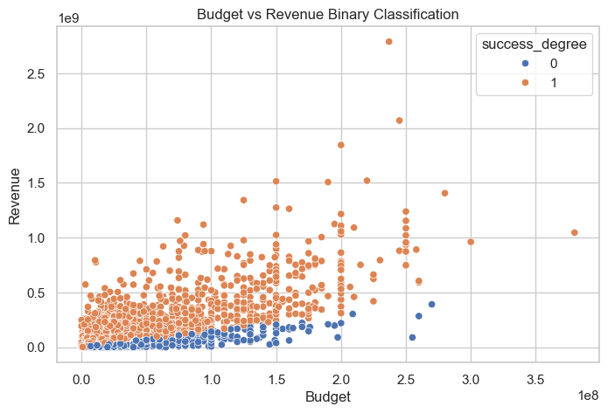

Slide 16
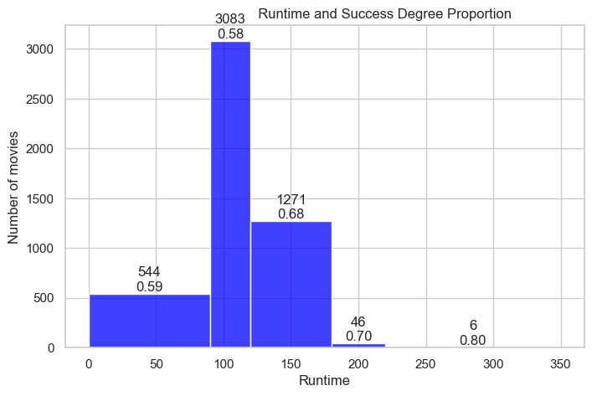

Slide 17
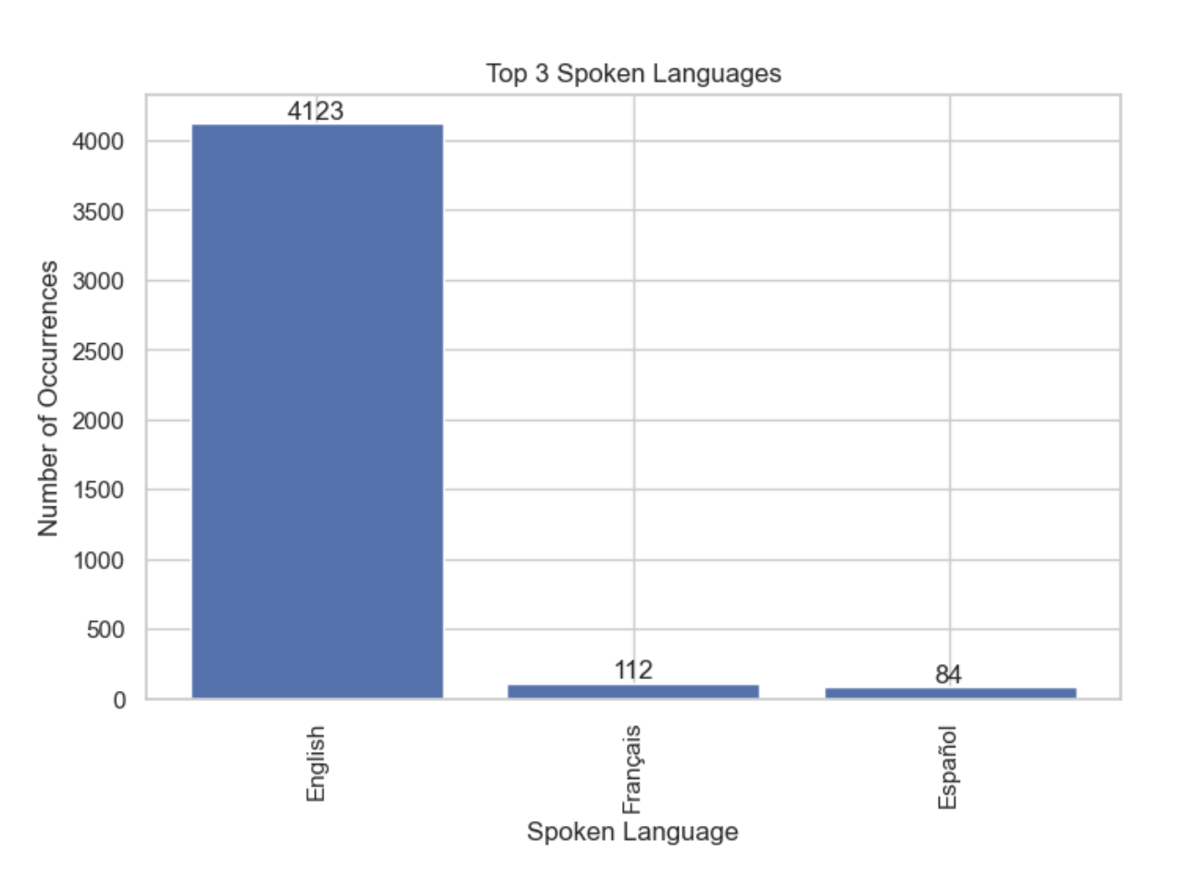

Slide 18
Classification

Slide 19
Feature Selection
Selected budget, runtime, release_year,release_month, genre,production_company, production_country, main_cast, director
Scaled the numeric features and one hot encoded the categorical features
Many categories occured since many unique categorical features

Slide 20
Train Test Split
90% training and 10% testing
Based on release_year; latest 10% was used for testing while the rest before that for training

Slide 21
Results

Slide 22
Binary Classification (without fine-tuning)
Model | Testing Accuracy | Params
Logistic Regression | 65.45 % | max_iter = 1000
KNN | 65.05 % | n_neighbours = 10
Decision Tree | 60 % | max_depth = 10
Random Forest | 62.82 % | Default (n_estimators = 100, min_samples_split = 2, min_samples_leaf = 1)

Slide 23
Fine-Tuning
For Logistic Regression and KNN, used GridSearchCV and TimeSeriesSplit
For Decision Trees, manually used nested for loops to assign different values of max_depth, min_samples_split and min_samples_leaf and get the max accuracy.The previous method was leading to lower accuracy
For Random Forests: Similar to Decision Trees

Slide 24
Binary Classification (after fine-tuning)
Model | Testing Accuracy | Params
Logistic Regression | 66.46% | {'C': 0.1, 'solver': 'liblinear'} max_iter = 1000
KNN | 65.05% (same as earlier) | {'n_neighbors': 50}
Decision Tree | 60.80% | max_depth = 10, min_samples_split = 9, min_samples_leaf=1
Random Forest | 65.25% | n_estimators=200, min_samples_split=2, min_samples_leaf = 1

Slide 25
Comparative Analysis and interpretation
Logistic Regression has a relatively high accuracy since there is one feature (budget) which has a very high correlation with revenue compared to other features, and hence influences the success_degree by a large margin. So decision boundary becomes very linear
Decision Tree performs poorly due to the one hot encoding of the many categories
The following were all one hot encoded:
Number of unique production_companies: 1278
Number of unique production_countries: 36
Number of unique main_cast: 1962
Number of unique director: 2163

Slide 26
Comparative Analysis
KNN
Can capture nonlinear relationships like the one exhibited by release_month
But due to high dimensions, it’s accuracy is slightly lower than logistic regression
Intuitively, it has a comparatively high accuracy since we put “similar” movies near each other based on various metrics into the same category
Random forest
Can handle the high dimensions introduced by one hot encoding
It can handle outliers like movies that have a rare actor and low budget

